Slide 1

Exploratory Data Analysis of Diamond Prices
Michael Pacheco
DSC 530 T303
Prof. Metzger

Slide 2

Statistical/Hypothetical Question
Does the carat weight of a diamond have a significant impact on its price?
Notes:
Notes to presenter:
What is your purpose for sharing this reflection?
Is it at the end of a unit or project?
Are you sharing this reflection, at the attainment of a learning goal you set for yourself?
Is it at the end of a course?
State your purpose for the reflection or even the purpose of the learning experience or learning goal. Be clear and be specific in stating your purpose.

Slide 3

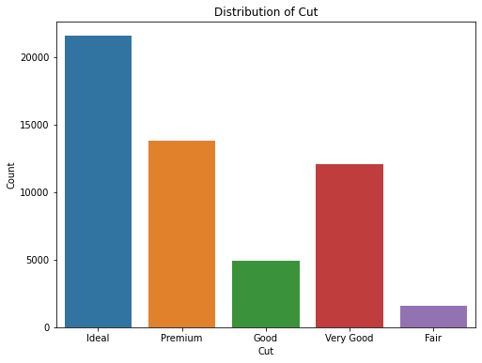
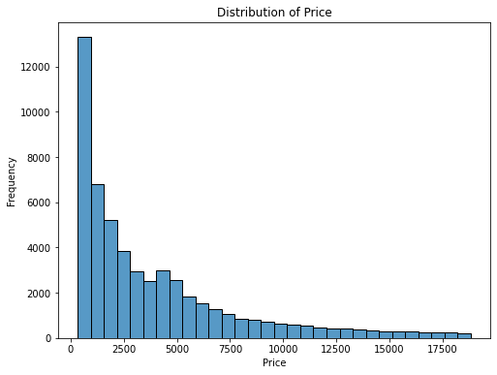
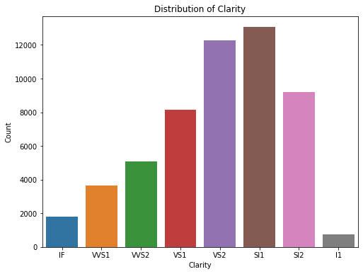
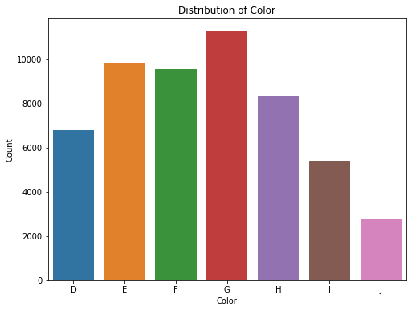
Exploratory Data Analysis (EDA) outcomes
Histograms of variables:
Price
Carat
Cut
Clarity
Color
Notes:
Notes to presenter:
Description of what you learned in your own words on one side.
Include information about the topic
Details about the topic will also be helpful here.
Tell the story of your learning experience. Just like a story there should always be a beginning, middle and an end.
On the other side, you can add a graphic that provides evidence of what you learned.
Feel free to use more than one slide to reflect upon your process. It also helps to add some video of your process.

Slide 4
Descriptive characteristics of variables
Mean
Mean carat weight: 0.79
Mean price: 3932.79
Mode
Mode carat weight: 0.3
Mode price: 605
Spread
SD of carat weight: 0.47
SD of price: 3989.43
Tail
Skewness of carat weight: 1.11
Kurtosis of carat weight: 1.25
Skewness of price: 1.618395283383529
Kurtosis of price: 2.17769575924869
Notes:
Notes to presenter:
Description of what you learned in your own words on one side.
Include information about the topic
Details about the topic will also be helpful here.
Tell the story of your learning experience. Just like a story there should always be a beginning, middle and an end.
On the other side, you can add a graphic that provides evidence of what you learned.
Feel free to use more than one slide to reflect upon your process. It also helps to add some video of your process.

Slide 5
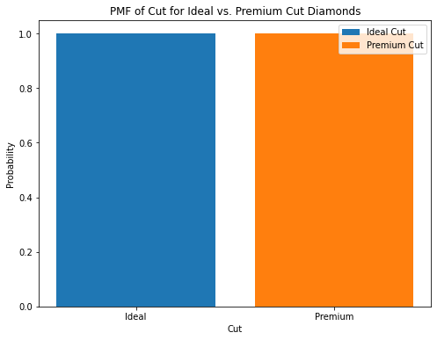
Probability Mass Function (PMF):
Comparison of scenarios using the carat variable
PMF of carat for different cut categories (e.g., Ideal, Premium, etc.)
Notes:
Notes to presenter:
Description of what you learned in your own words on one side.
Include information about the topic
Details about the topic will also be helpful here.
Tell the story of your learning experience. Just like a story there should always be a beginning, middle and an end.
On the other side, you can add a graphic that provides evidence of what you learned.
Feel free to use more than one slide to reflect upon your process. It also helps to add some video of your process.

Slide 6
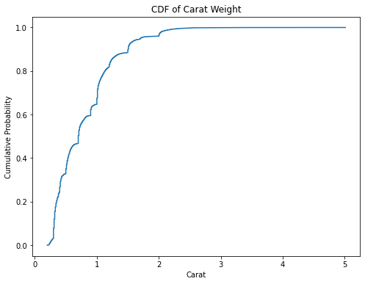
Cumulative Distribution Function (CDF):
Construction and interpretation of a CDF plot for carat
Understanding the distribution of carat values
Notes:
Notes to presenter:
Description of what you learned in your own words on one side.
Include information about the topic
Details about the topic will also be helpful here.
Tell the story of your learning experience. Just like a story there should always be a beginning, middle and an end.
On the other side, you can add a graphic that provides evidence of what you learned.
Feel free to use more than one slide to reflect upon your process. It also helps to add some video of your process.

Slide 7
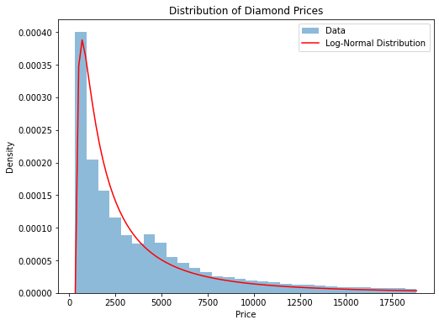
Analytical Distribution:
Selection of a suitable analytical distribution (e.g., Gaussian, exponential, etc.)
Application of the selected distribution to the dataset
Analysis of how well the distribution fits the data
Notes:
Notes to presenter:
Description of what you learned in your own words on one side.
Include information about the topic
Details about the topic will also be helpful here.
Tell the story of your learning experience. Just like a story there should always be a beginning, middle and an end.
On the other side, you can add a graphic that provides evidence of what you learned.
Feel free to use more than one slide to reflect upon your process. It also helps to add some video of your process.

Slide 8
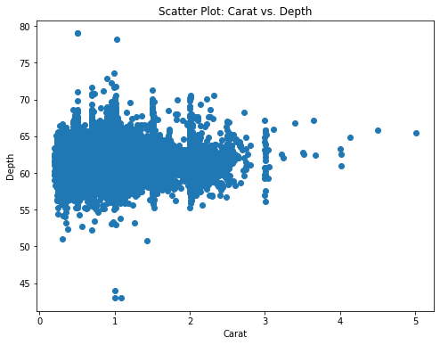
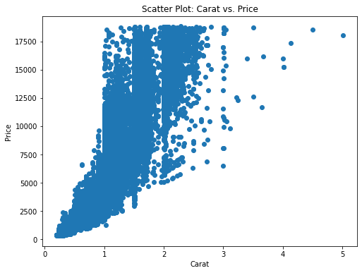
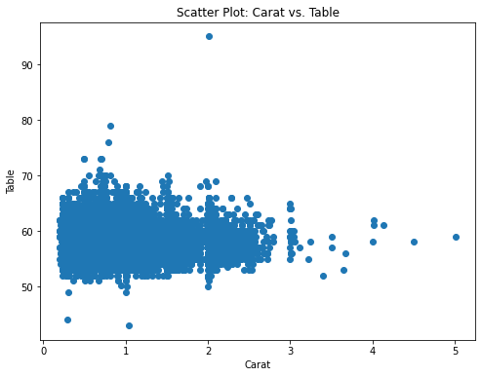
Scatter Plots and Correlation:
Scatter plot of carat vs. price
Analysis of correlation and covariance between variables
Consideration of Pearson's correlation coefficient
Notes:
Notes to presenter:
Description of what you learned in your own words on one side.
Include information about the topic
Details about the topic will also be helpful here.
Tell the story of your learning experience. Just like a story there should always be a beginning, middle and an end.
On the other side, you can add a graphic that provides evidence of what you learned.
Feel free to use more than one slide to reflect upon your process. It also helps to add some video of your process.

Slide 9
Regression Analysis:
OLS Regression Results
==============================================================================
Dep. Variable: price R-squared: 0.849
Model: OLS Adj. R-squared: 0.849
Method: Least Squares F-statistic: 3.041e+05
Date: Wed, 24 May 2023 Prob (F-statistic): 0.00
Time: 21:46:01 Log-Likelihood: -4.7273e+05
No. Observations: 53940 AIC: 9.455e+05
Df Residuals: 53938 BIC: 9.455e+05
Df Model: 1
Covariance Type: nonrobust
==============================================================================
coef std err t P>|t| [0.025 0.975]
------------------------------------------------------------------------------
const -2256.3606 13.055 -172.830 0.000 -2281.949 -2230.772
carat 7756.4256 14.067 551.408 0.000 7728.855 7783.996
==============================================================================
Omnibus: 14025.341 Durbin-Watson: 0.986
Prob(Omnibus): 0.000 Jarque-Bera (JB): 153030.525
Skew: 0.939 Prob(JB): 0.00
Kurtosis: 11.035 Cond. No. 3.65
==============================================================================
Linear regression model between carat and price
Interpretation of coefficients, p-values, and R-squared
Assessment of the impact of carat weight on diamond prices
Notes:
Notes to presenter:
Description of what you learned in your own words on one side.
Include information about the topic
Details about the topic will also be helpful here.
Tell the story of your learning experience. Just like a story there should always be a beginning, middle and an end.
On the other side, you can add a graphic that provides evidence of what you learned.
Feel free to use more than one slide to reflect upon your process. It also helps to add some video of your process.

Slide 10
Limitations and Further Research:
Missed aspects in the analysis
Potential variables that could enhance the analysis (e.g., cut, clarity, color)
Incorrect assumptions and potential nonlinear relationships
Notes:
Notes to presenter:
What is your purpose for sharing this reflection?
Is it at the end of a unit or project?
Are you sharing this reflection, at the attainment of a learning goal you set for yourself?
Is it at the end of a course?
State your purpose for the reflection or even the purpose of the learning experience or learning goal. Be clear and be specific in stating your purpose.

Slide 11
Questions?
Thanks

